Slide 1
Arianna Privato
ML Project
How can we protect ourselves and our children from dangerous comments online?
Detecting Cyberbullying with NLP

Slide 2
CONTENTS
0. What is Cyberbullying?
Exploratory Data Analysis
NLP Machine Learning
Conclusions
Credits

Slide 3
What is Cyberbullying?
Reasons | Percentage of Cyberbullying
Appearance | 61%
Academic Achievement | 25%
Race | 17%
Sexuality | 15%
Financial Status | 15%
Religion | 11%
Other | 20%
Cyberbullying involves repeatedly posting offensive content about someone on social media or other websites, including spreading lies through live-streaming apps, group texts, and social media. The goal is to make the victim feel anxious, angry, depressed, embarrassed, scared, sad, or even suicidal.
0. What is cyberbullying?

Slide 4
Did you know?
What can You do about it?
60% of all internet users have been cyberbullied, harassed, or abused online.
https://stopcyberbullyingday.org/
69% of those who admitted to cyberbullying have also disclosed that they have bullied others in person.
Florida Atlantic University
64% of students who have been cyberbullied say it affects their ability to learn and feel safe at school.
Cyberbullying Research Center
0. What is cyberbullying?

Slide 5
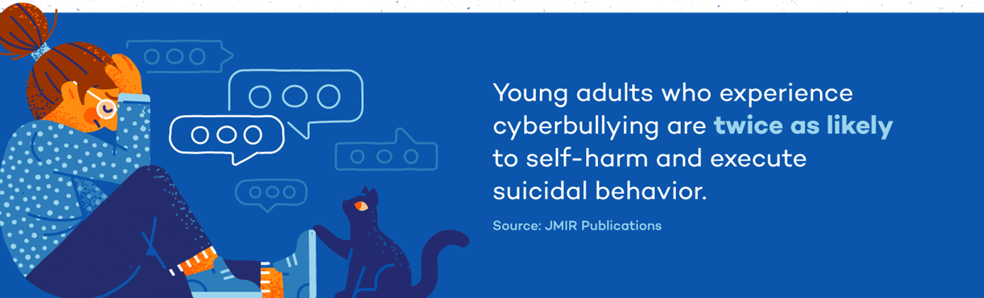
Consequences
68% of children that have gone through online harassment have experienced mental health issues.
The effects of the vice include stress, depression, anxiety, and loss of empathy, amongst others.
Cyberbullying
0. What is cyberbullying?

Slide 6
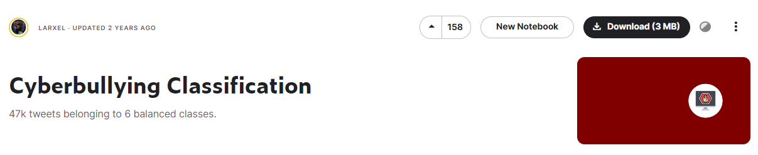
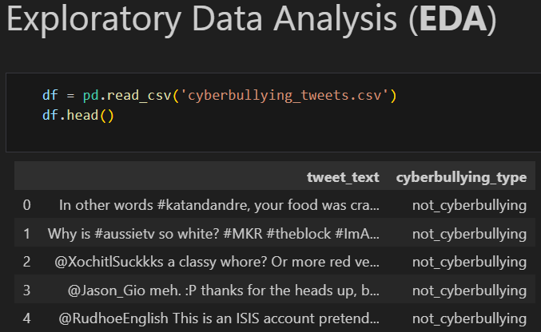
Exploratory Data Analysis

Slide 7
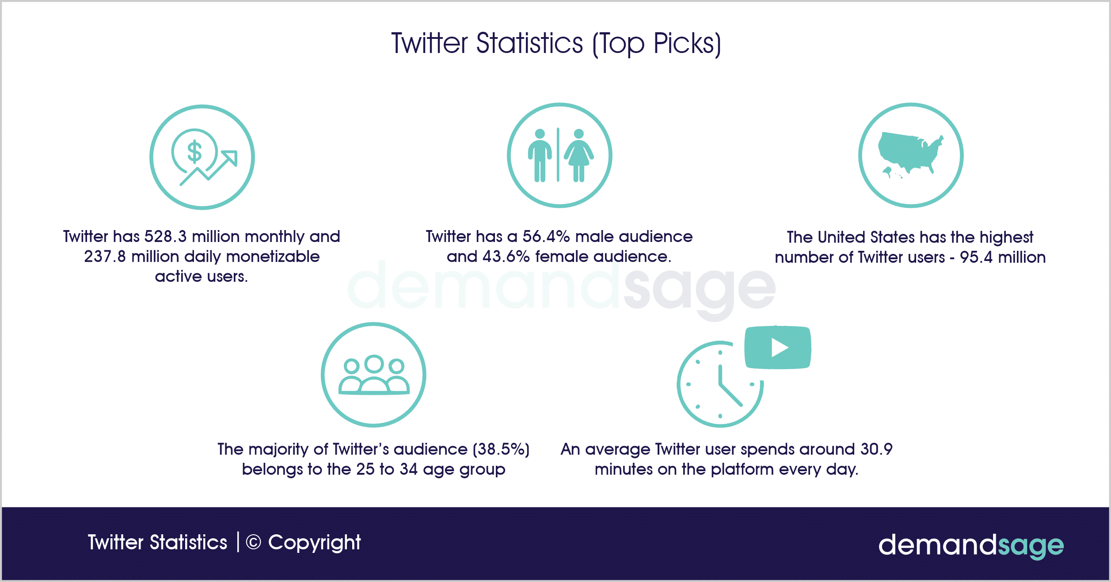
Did you know?
Exploratory Data Analysis

Slide 8
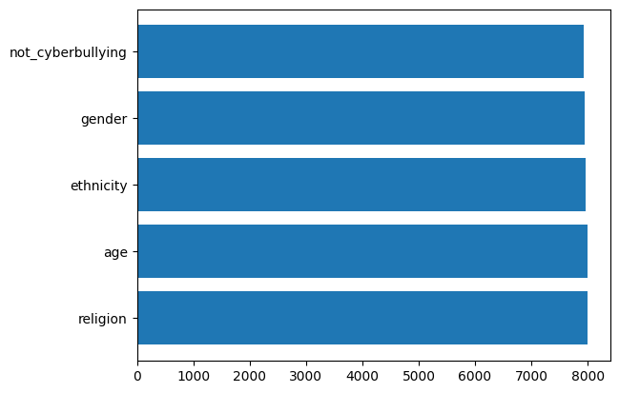
DATASET BY CATEGORIES
Exploratory Data Analysis

Slide 9
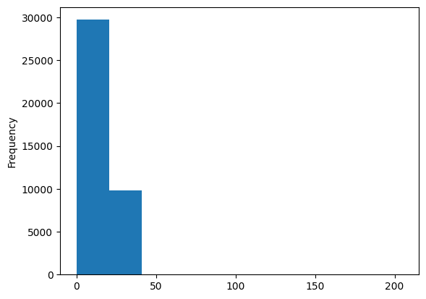
DATASET BY TWEET LENGHT
Exploratory Data Analysis

Slide 10
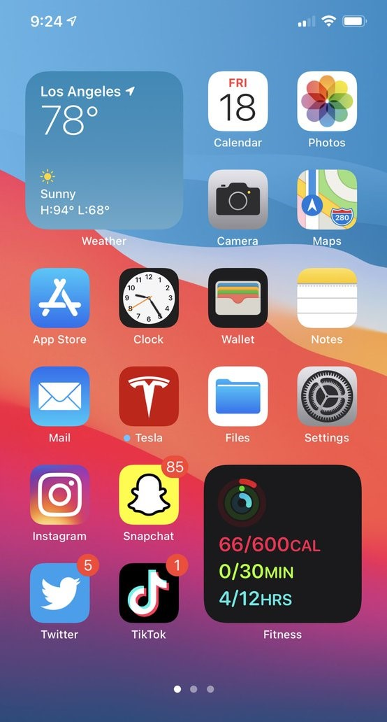
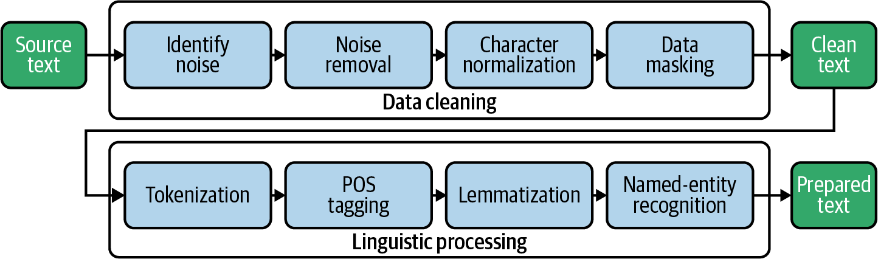
2. NLP Machine Learning
INTRO
NLP
Text cleaning

Slide 11
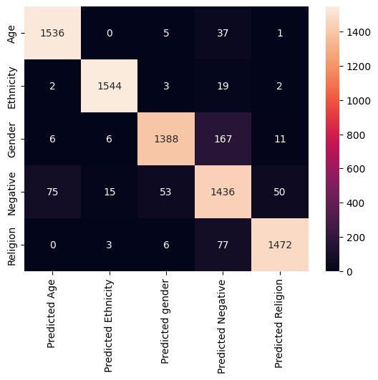
LINEAR MODEL
MODEL
1
93%
Accuracy

Slide 12

LSTM MODEL
MODEL
2
94%
Accuracy

Slide 13

TRANSFORMERS MODEL
MODEL
3
93%
Accuracy

Slide 14
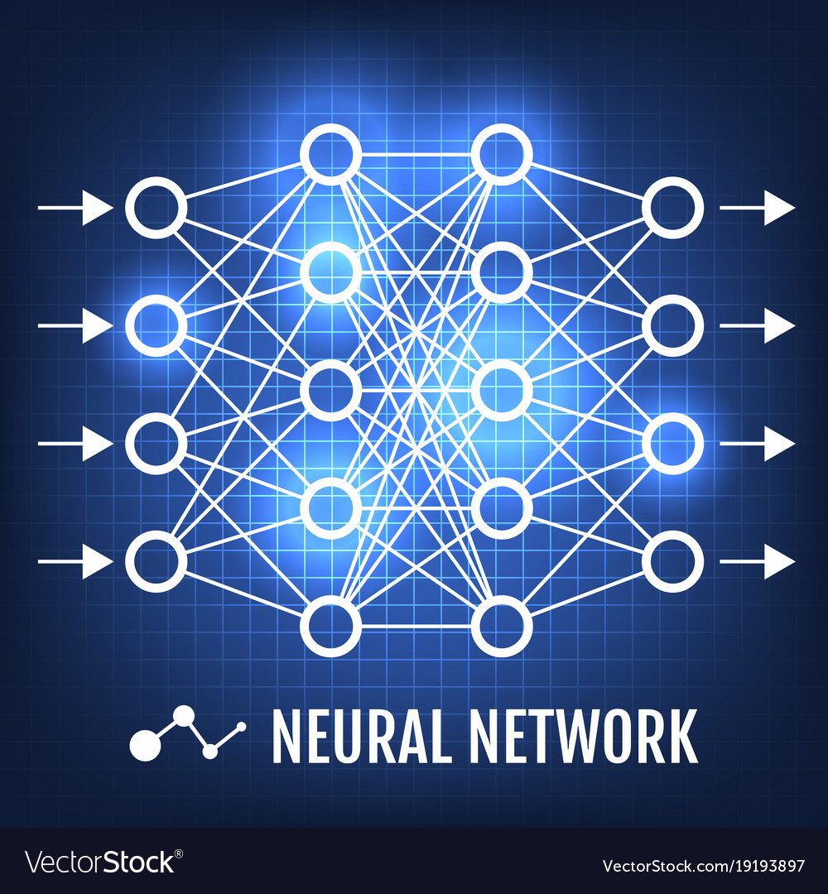
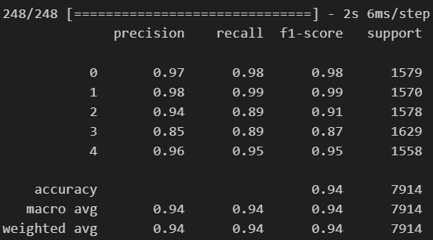
CONCLUSIONS
BEST RESULT LSTM MODEL
3. Conclusions

Slide 15
THANK YOU
Feel free to ask questions

